Slide 1
ConGrad
By Jieyu Ren, Qi Cheng, Zijun Liu, Denglin Zhang, Hao Yang, Tao Huang

Slide 2

Background
Graduate School Application
Decision Making
Applying To Specific Programs
Research Every School’s programs & rankings
Estimate the Chance of Being Accepted

Slide 3
Features
Search box
Information Display of Programs & Schools
Schools & Programs
Admission Results
Estimation of acceptance rantes
Database Update
Recommendation

Slide 4
Information Collection (Lin)
Schools (name, location, ranking)
Overall ranking from US News & Report
10 Graduate Programs from official websites (major, tuition, degree, program size, duration)
Students (GPA, GRE, TOEFL, publication, working time, major, etc.)
Online Forums:
Gradcafe: https://www.thegradcafe.com/
Offerduoduo: https://offer.1point3acres.com/

Slide 5
Database
Entity Tables
School
Program
Student
Relation Tables
Has
Admit
Graduate

Slide 6
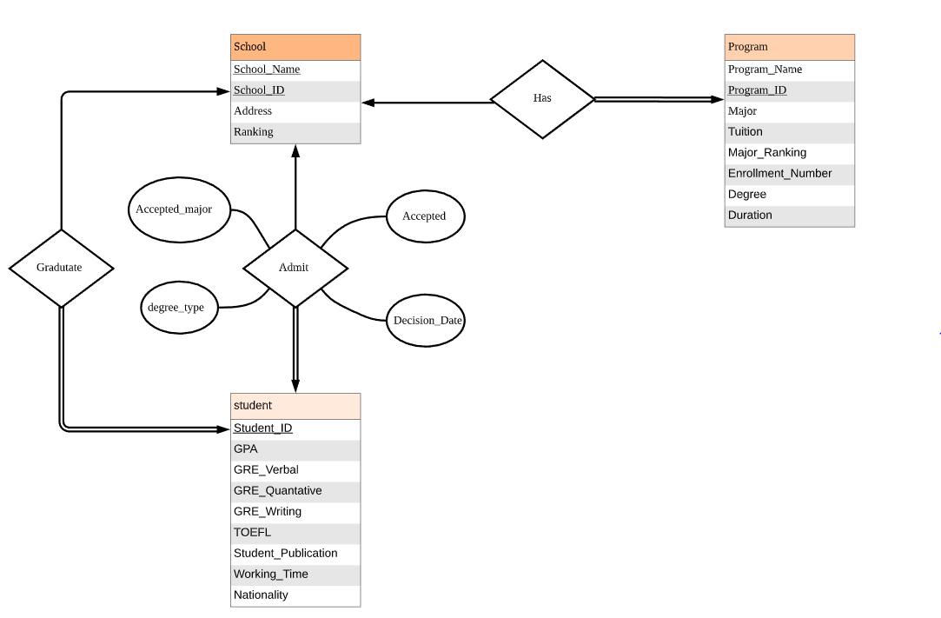

Slide 7
Search
Users input program names
DBconnect
Return search results

Slide 8
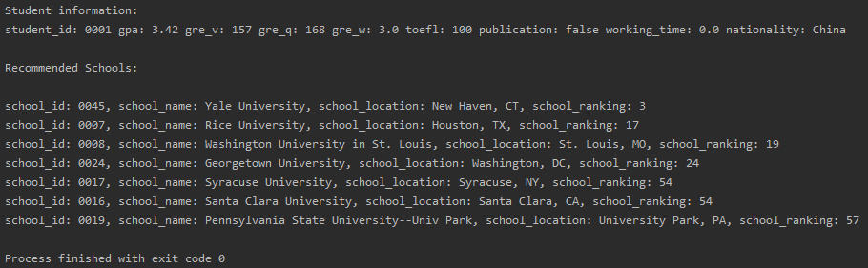
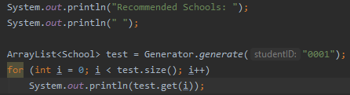
Connectors and Recommendation (Jieyu Ren)
DBConnect
ProgramDBConnect
SchoolDBConnect
StudentDBConnect
Generator
Program, Student, School, Generator.ect
Example input and output:

Slide 9
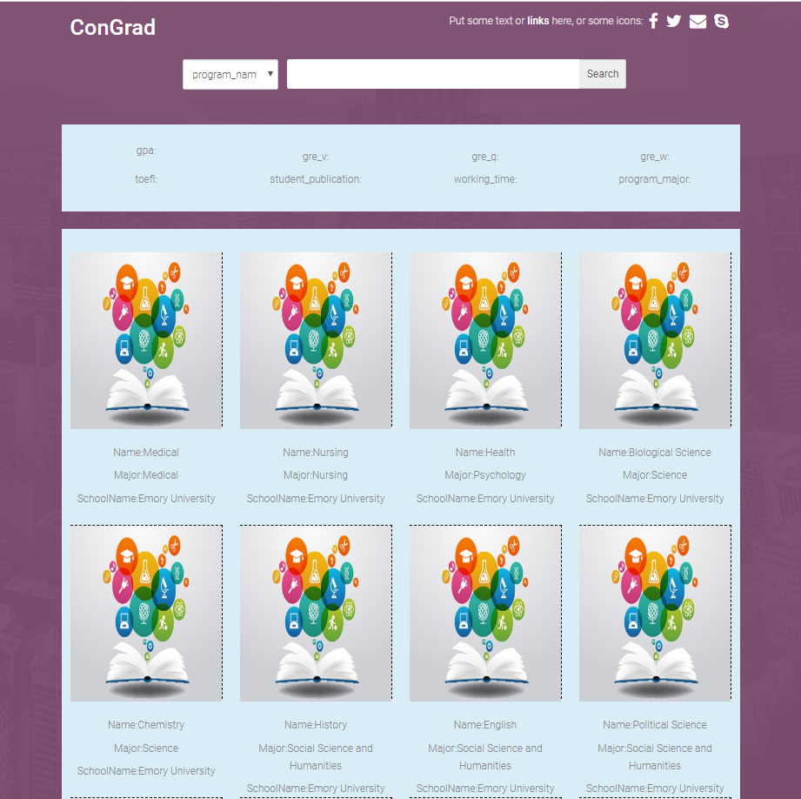
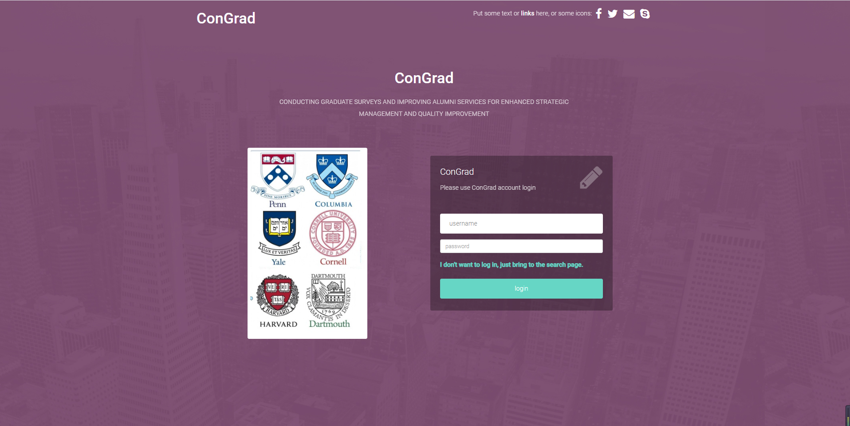
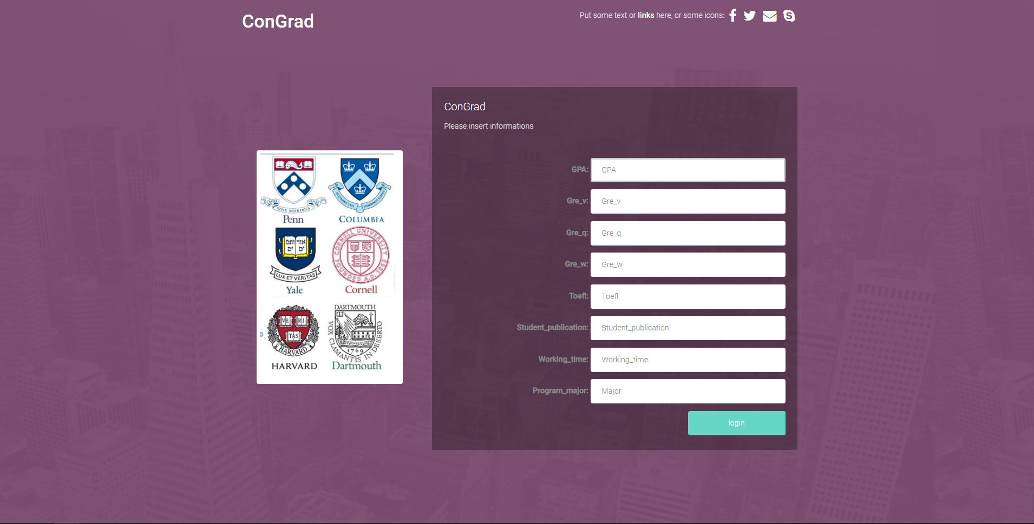
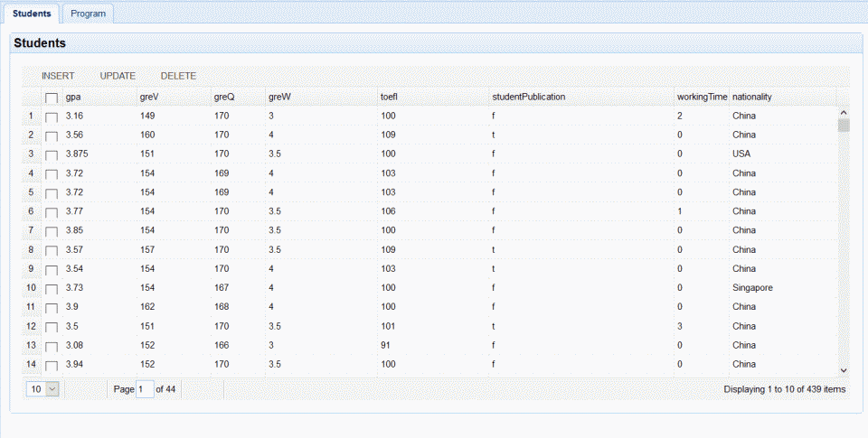
UI(Tao Huang)

Slide 10
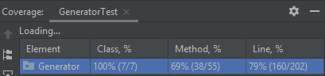
Code Test(Jieyu Ren)
Junit
GeneratorTest, SearchTest
Coverage:

Slide 11
Demo

Slide 12
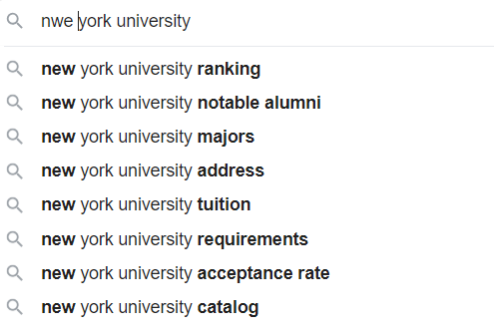
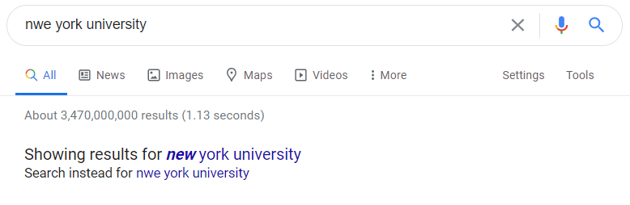
Future Work (Hao Yang)
Code Test
More Information Collection
Search Algorithm
Spell Checker Algorithm
Spell Suggestion Algorithm

Slide 13
References
Gradcafe: https://www.thegradcafe.com/
Offerduoduo: https://offer.1point3acres.com/
US News: https://www.usnews.com/best-colleges/

Slide 14
Any Questions?

Slide 15
Thanks for watching!

